Slide 1
Erasure Codes for Systems
COS 518: Advanced Computer Systems
Lecture 19
Wyatt Lloyd

Slide 2
Things Fail, Let’s Not Lose Data
How?

Slide 3
Things Fail, Let’s Not Lose Data
How?
Replication
Store multiple copies of the data
Simple and very commonly used!
But, requires a lot of extra storage
Erasure coding
Store extra information we can use to recover the data
Fault tolerance with less storage overhead
Today’s topic!

Slide 4
Erasure Codes vs Error Correcting Codes
Error correcting code (ECC):
Protects against errors is data, i.e., silent corruptions
Bit flips can happen in memory -> use ECC memory
Bits can flip in network transmissions -> use ECCs
Erasure code:
Data is erased, i.e., we know it’s not there
Cheaper/easier than ECC
Special case of ECC
What we’ll discuss today and use in practice
Protect against errors with checksums

Slide 5
Erasure Codes, a simple example w/ XOR
A
B
A⊕B

Slide 6
Erasure Codes, a simple example w/ XOR
A
B
A⊕B

Slide 7
Erasure Codes, a simple example w/ XOR
A
B
A⊕B
A
=
B
⊕
A⊕B

Slide 8
Reed-Solomon Codes (1960)
N data blocks
K coding blocks
M = N+K total blocks
Recover any block from any N other blocks!
Tolerates up to K simultaneous failures
Works for any N and K (within reason)

Slide 9
Reed-Solomon Code Notation
N data blocks
K coding blocks
M = N+K total blocks
RS(N,K)
(10,4): 10 data blocks, 4 coding blocks
f4 uses this, FB HDFS for data warehouse does too
Will also see (M, N) notation sometimes
(14,10): 14 total blocks, 10 data blocks, (4 coding blocks)

Slide 10
Reed-Solomon Codes, How They Work
Galois field arithmetic is the secret sauce
Details aren’t important for us ☺
See “J. S. Plank. A tutorial on Reed-Solomon coding for fault-tolerance in RAID-like systems. Software—Practice & Experience 27(9):995–1012, September 1997.”

Slide 11
Reed-Solomon (4,2) Example
A
B
C
D
1
2

Slide 12
Reed-Solomon (4,2) Example
A
B
C
D
1
2

Slide 13
Reed-Solomon (4,2) Example
A
B
C
D
1
2
A
=
B
C
+
D
+
1
+

Slide 14
Reed-Solomon (4,2) Example
A
B
C
D
1
2
A
=
B
C
+
D
+
1
+
=
=
=
A
=
C
D
+
1
+
2
+

Slide 15
Erasure Codes Save Storage
Tolerating 2 failures
3x replication = ___ storage overhead

Slide 16
Erasure Codes Save Storage
Tolerating 2 failures
3x replication = 3x storage overhead
RS(4,2) = ___ storage overhead

Slide 17
Erasure Codes Save Storage
Tolerating 2 failures
3x replication = 3x storage overhead
RS(4,2) = (4+2)/4 = 1.5x storage overhead

Slide 18
Erasure Codes Save Storage
Tolerating 2 failures
3x replication = 3x storage overhead
RS(4,2) = (4+2)/4 = 1.5x storage overhead
Tolerating 4 failures
5x replication = 5x storage overhead
RS(10,4) = ___ storage overhead

Slide 19
Erasure Codes Save Storage
Tolerating 2 failures
3x replication = 3x storage overhead
RS(4,2) = (4+2)/4 = 1.5x storage overhead
Tolerating 4 failures
5x replication = 5x storage overhead
RS(10,4) = (10+4)/10 = 1.4x storage overhead
RS(100,4) = ___ storage overhead

Slide 20
Erasure Codes Save Storage
Tolerating 2 failures
3x replication = 3x storage overhead
RS(4,2) = (4+2)/4 = 1.5x storage overhead
Tolerating 4 failures
5x replication = 5x storage overhead
RS(10,4) = (10+4)/10 = 1.4x storage overhead
RS(100,4) = (100+4)/100 = 1.04x storage overhead

Slide 21
What’s the Catch?

Slide 22
Catch 1: Encoding Overhead
Replication:
Just copy the data
Erasure coding:
Compute codes over N data blocks for each of the K coding blocks

Slide 23
Catch 2: Decoding Overhead
Replication
Just read the data
Erasure Coding

Slide 24
Catch 2: Decoding Overhead
Replication
Just read the data
Erasure Coding
Normal case is no failures -> just read the data!
If there are failures
Read N blocks from disks and over the network
Compute code over N blocks to reconstruct the failed block

Slide 25
Catch 3: Updating Overhead
Replication:
Update the data in each copy
Erasure coding
Update the data in the data block
And all of the coding blocks

Slide 26
Catch 3’: Deleting Overhead
Replication:
Delete the data in each copy
Erasure coding
Delete the data in the data block
Update all of the coding blocks

Slide 27
Catch 4: Update Consistency
Replication:
Erasure coding

Slide 28
Catch 4: Update Consistency
Replication:
Consensus protocol (Paxos!)
Erasure coding
Need to consistently update all coding blocks with a data block
Need to consistently apply updates in a total order across all blocks
Need to ensure reads, including decoding, are consistent

Slide 29
Catch 5: Fewer Copies for Reading
Replication
Read from any of the copies
Erasure coding
Read from the data block
Or reconstruct the data on fly if there is a failure

Slide 30
Catch 6: Larger Min System Size
Replication
Need K+1 disjoint places to store data
e.g., 3 disks for 3x replication
Erasure coding
Need M=N+K disjoint places to store data
e.g., 14 disks for RS(10,4) replication

Slide 31
What’s the Catch?
Encoding overhead
Decoding overhead
Updating overhead
Deleting overhead
Update consistency
Fewer copies for serving reads
Larger minimum system size

Slide 32
Many Different Codes
See “Erasure Codes for Storage Systems, A Brief Primer. James S. Plank. Usenix ;login: Dec 2013” for a good jumping off point
Also a good, accessible resource generally

Slide 33
Different codes make different tradeoffs
Encoding, decoding, and updating overheads
Storage overheads
Best are “Maximum Distance Separable” or “MDS” codes where K extra blocks allows you to tolerate any K failures
Configuration options
Some allow any (N,K), some restrict choices of N and K

Slide 34
Erasure Coding Big Picture
Huge Positive
Fault tolerance with less storage overhead!
Many drawbacks
Encoding overhead
Decoding overhead
Updating overhead
Deleting overhead
Update consistency
Fewer copies for serving reads
Larger minimum system size

Slide 35
Let’s Use Our New Hammer!

Slide 36
Erasure Coding Big Picture
Huge Positive
Fault tolerance with less storage overhead!
Many drawbacks
Encoding overhead
Decoding overhead
Updating overhead
Deleting overhead
Update consistency
Fewer copies for serving reads
Larger minimum system size
Immutable data

Slide 37
Erasure Coding Big Picture
Huge Positive
Fault tolerance with less storage overhead!
Many drawbacks
Encoding overhead
Decoding overhead
Updating overhead
Deleting overhead
Update consistency
Fewer copies for serving reads
Larger minimum system size
Immutable data

Slide 38
Erasure Coding Big Picture
Huge Positive
Fault tolerance with less storage overhead!
Many drawbacks
Encoding overhead
Decoding overhead
Updating overhead
Deleting overhead
Update consistency
Fewer copies for serving reads
Larger minimum system size
Immutable data
Storing lots of data
(when storage overhead actually matters this is true)

Slide 39
Erasure Coding Big Picture
Huge Positive
Fault tolerance with less storage overhead!
Many drawbacks
Encoding overhead
Decoding overhead
Updating overhead
Deleting overhead
Update consistency
Fewer copies for serving reads
Larger minimum system size
Immutable data
Storing lots of data
(when storage overhead actually matters this is true)

Slide 40
Erasure Coding Big Picture
Huge Positive
Fault tolerance with less storage overhead!
Many drawbacks
Encoding overhead
Decoding overhead
Updating overhead
Deleting overhead
Update consistency
Fewer copies for serving reads
Larger minimum system size
Data is stored for a long time after being written
Immutable data
Storing lots of data
(when storage overhead actually matters this is true)

Slide 41
Erasure Coding Big Picture
Huge Positive
Fault tolerance with less storage overhead!
Many drawbacks
Encoding overhead
Decoding overhead
Updating overhead
Deleting overhead
Update consistency
Fewer copies for serving reads
Larger minimum system size
Low read rate
Data is stored for a long time after being written
Immutable data
Storing lots of data
(when storage overhead actually matters this is true)

Slide 42
Erasure Coding Big Picture
Huge Positive
Fault tolerance with less storage overhead!
Many drawbacks
Encoding overhead
Decoding overhead
Updating overhead
Deleting overhead
Update consistency
Fewer copies for serving reads
Larger minimum system size
Low read rate
Data is stored for a long time after being written
Immutable data
Storing lots of data
(when storage overhead actually matters this is true)

Slide 43
f4: Facebook’s Warm BLOB Storage System [OSDI ‘14]
Subramanian Muralidhar*, Wyatt Lloyd*ᵠ, Sabyasachi Roy*, Cory Hill*, Ernest Lin*, Weiwen Liu*, Satadru Pan*, Shiva Shankar*, Viswanath Sivakumar*, Linpeng Tang*⁺, Sanjeev Kumar*
*Facebook Inc., ᵠUniversity of Southern California, ⁺Princeton University
1

Slide 44

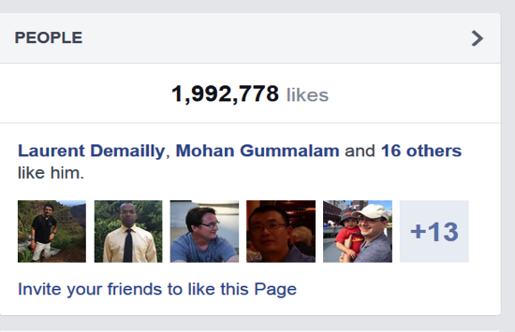
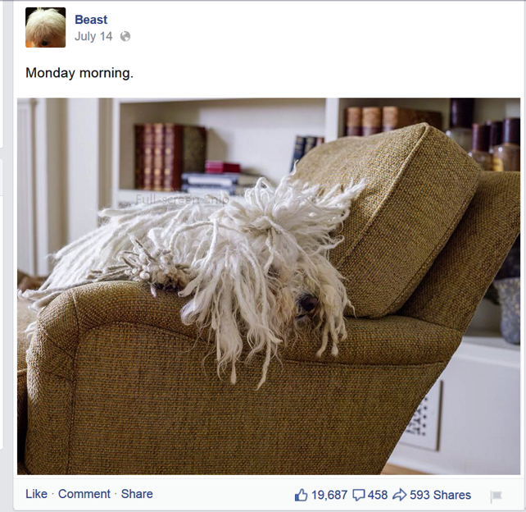
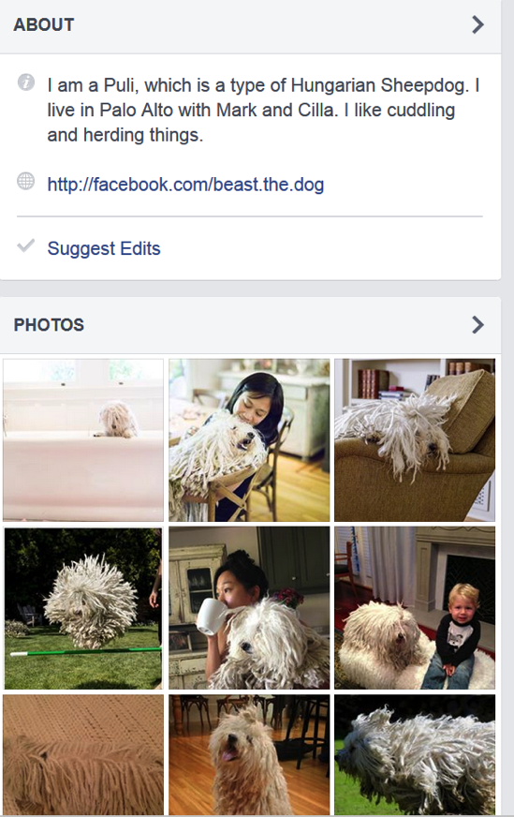
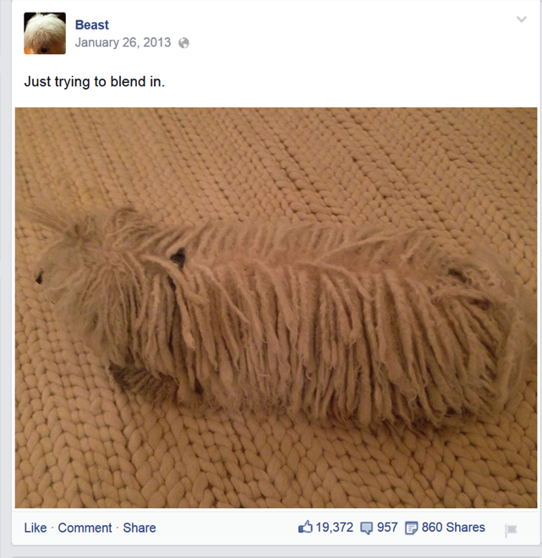
BLOBs@FB
Cover Photo
Profile Photo
Immutable
&
Unstructured
Feed Photo
Diverse
A LOT of them!!
Feed Video
2

Slide 45

590X
510X
HOT DATA
WARM DATA
Data cools off rapidly
98X
68X
30X
16X
14X
7X
6X
2X
1X
1X
< 1 Days
1 Day
1 Week
1 Month
3 Months
1 Year
3

Slide 46
Handling failures
3 Host failures
9 Disk failures
3 DC failures
3 Rack failures
DATACENTER
DATACENTER
DATACENTER
RACKS
RACKS
RACKS
HOST
HOST
HOST
1.2
Replication:
* 3 = 3.6
4

Slide 47
Handling load
HOST
HOST
HOST
HOST
HOST
HOST
HOST
6
Reduce space usage
AND
Not compromise reliability
5

Slide 48
Background: Data serving
CDN protects storage
Router abstracts storage
Web tier adds business logic
User Requests
Writes
Reads
CDN
Web Servers
Router
BLOB
Storage
6

Slide 49
Background: Haystack [OSDI2010]
Volume is a series of BLOBs
In-memory index
Header
BID1: Off
BLOB1
BID2: Off
Footer
Header
BIDN: Off
BLOB1
In-Memory Index
Footer
Header
BLOB1
Footer
Volume
7

Slide 50
Introducing f4: Haystack on cells
Rack
Rack
Rack
Data+Index
Cell
Compute
8

Slide 51
Data splitting
10G Volume
Reed Solomon Encoding
4G parity
Stripe1
Stripe2
BLOB4
BLOB1
BLOB4
BLOB6
BLOB8
BLOB10
BLOB5
RS
BLOB2
BLOB5
=>
BLOB2
BLOB11
BLOB7
BLOB9
BLOB3
BLOB4
RS
=>
BLOB2
9

Slide 52
Data placement
10G Volume
4G parity
Stripe1
Stripe2
RS
RS
Cell with 7 Racks
Reed Solomon (10, 4) is used in practice (1.4X)
Tolerates 4 racks (→ 4 disk/host ) failures
10

Slide 53
Reads
Router
Storage Nodes
Index
Read
Index
User
Request
Data
Read
Compute
Cell
2-phase: Index read returns the exact physical location of the BLOB
11

Slide 54
Reads under cell-local failures
Router
Storage Nodes
Index
Read
Index
User
Request
Data
Read
Compute (Decoders)
Decode
Read
Cell
Cell-Local failures (disks/hosts/racks) handled locally
12

Slide 55
Reads under datacenter failures (2.8X)
Router
User
Request
Compute (Decoders)
Proxying
Cell in Datacenter1
Compute (Decoders)
Mirror Cell in Datacenter2
2 * 1.4X = 2.8X
13

Slide 56
Cross datacenter XOR
(1.5 * 1.4 = 2.1X)
67%
Index
Cell in
Datacenter1
33%
Index
Cell in
Datacenter2
Index
Cell in
Datacenter3
Cross –DC
index copy
14

Slide 57
Reads with datacenter failures (2.1X)
Router
Index
Data
Read
User
Request
Router
XOR
Index
Index
Read
Data
Read
Index
Index
Router
15

Slide 58
Haystack v/s f4 2.8 v/s f4 2.1
 | Haystack with 3 copies | f4 2.8 | f4 2.1
Replication | 3.6X | 2.8X | 2.1X
Irrecoverable Disk Failures | 9 | 10 | 10
Irrecoverable Host Failures | 3 | 10 | 10
Irrecoverable Rack failures | 3 | 10 | 10
Irrecoverable Datacenter failures | 3 | 2 | 2
Load split | 3X | 2X | 1X
16

Slide 59
Evaluation
What and how much data is “warm”?
Can f4 satisfy throughput and latency requirements?
How much space does f4 save
f4 failure resilience
17

Slide 60
Methodology
CDN data: 1 day, 0.5% sampling
BLOB store data: 2 week, 0.1%
Random distribution of BLOBs assumed
The worst case rates reported
18

Slide 61
Hot and warm divide
HOT DATA
WARM DATA
< 3 months → Haystack
> 3 months → f4
80 Reads/Sec
19

Slide 62
It is warm, not cold
Haystack (50%)
F4 (50%)
HOT DATA
WARM DATA
20

Slide 63
f4 Performance: Most loaded disk in cluster
Peak load on disk: 35 Reads/Sec
Reads/Sec
21

Slide 64
f4 Performance: Latency
P80 = 30ms
P99 = 80ms
22

Slide 65
Concluding Remarks
Facebook’s BLOB storage is big and growing
BLOBs cool down with age
~100X drop in read requests in 60 days
Haystack’s 3.6X replication over provisioning for old, warm data.
f4 encodes data to lower replication to 2.1X
23

Slide 67
Student Presentation The Akamai Netwowrk: A Platform for High-Performance internet Applications
COS 518: Advanced Computer Systems
Fei Gao
4/17/2018

Slide 68
Problem: Internet Delivery Challenges
Peering point congestion (middle mile)
Inefficient routing/communication protocols
Unreliable networks
Scalability
Application limitations and slow rate of change adoption

Slide 69
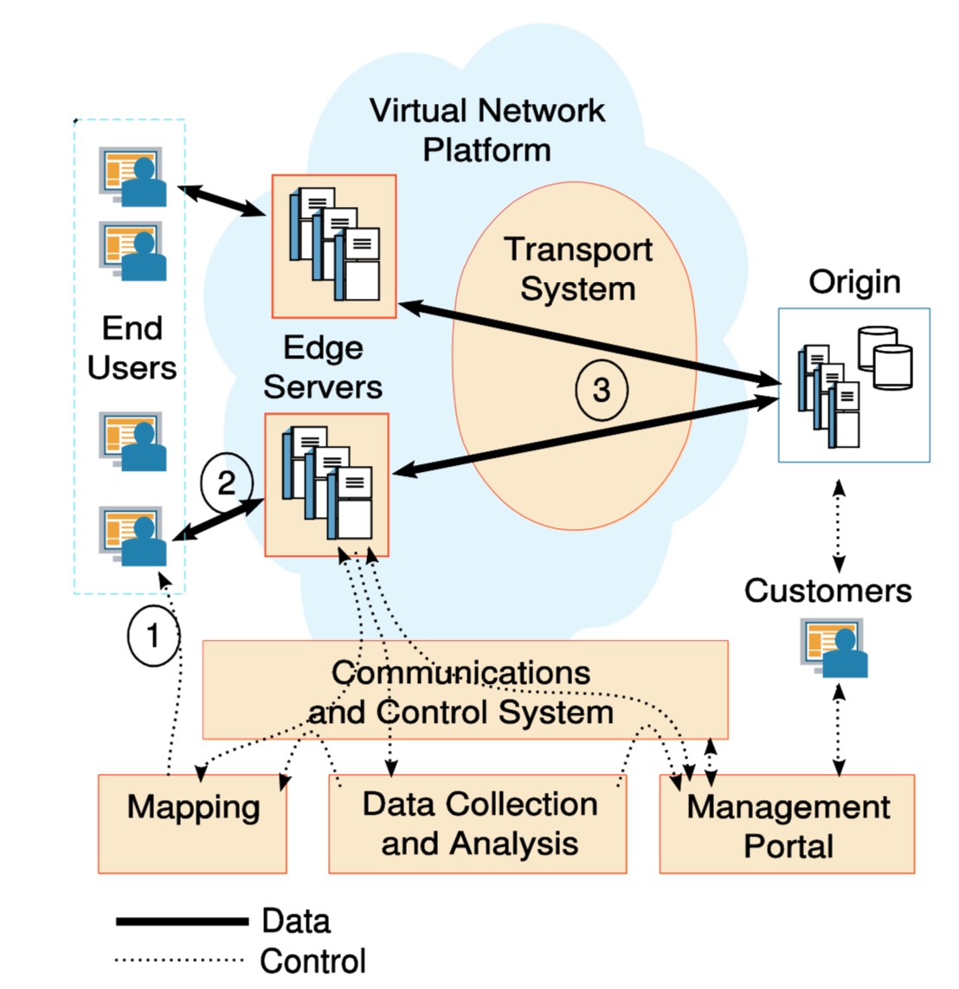
Delivery Network Overview
set up configurations
collect server log

Slide 70
Transport System
Content and Streaming Media Delivery
Application Delivery
Reflector
Parent server B
Edge server
Entrypoint
Reflector
Edge server A
Server C
Edge server
Entrypoint
Reflector

Slide 71
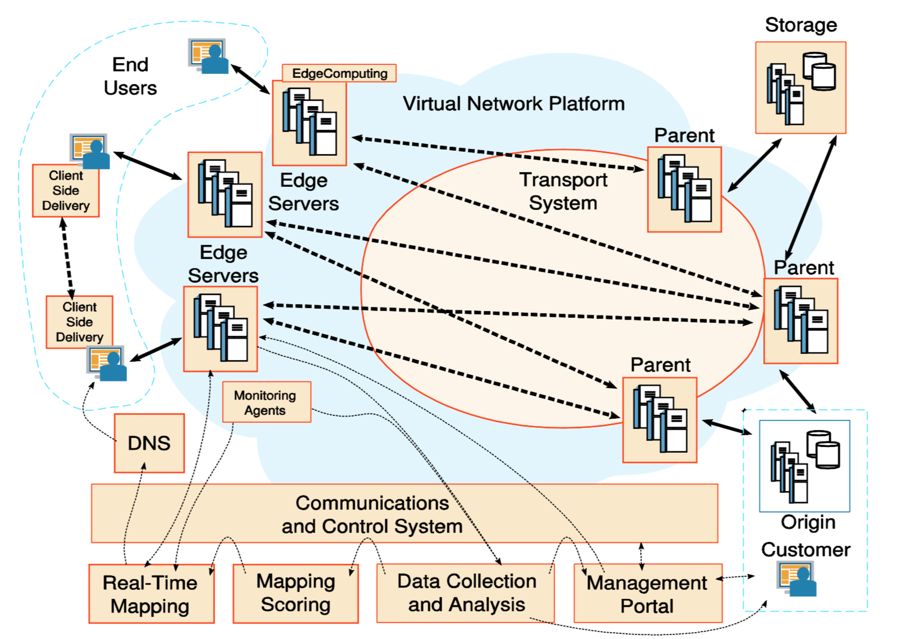
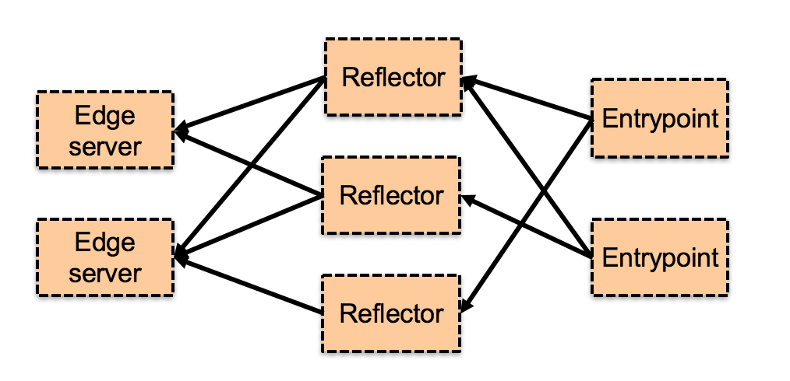
Content Delivery
Deploy servers as close to users as possible
Thousands of edge-based servers
Tiered Distribution
Overlay network for Live Streaming

Slide 72
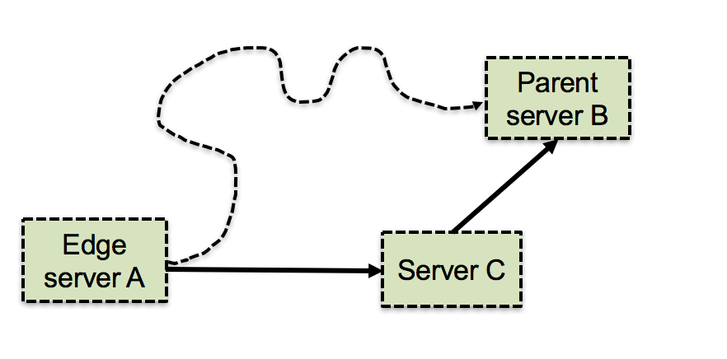
Application Delivery
Speed up long-haul Internet communications by using the Akamai platform as a high-performance overlay network.
Path optimization / Multiple paths
Packet loss reduction
Transport protocol optimizations
Pools of persistent connections
Intelligent TCP window size and retransmission based on the network latency information
Application optimization
Push application logic from the origin server out to the edge of the Internet.
EdgeComputing
Applications that does not rely on huge transactional databases
Push application logic from the origin server out to the edge of the Internet.

Slide 73
Edge Server Platform
Origin server location
Cache control/indexing
Access control
Response to origin failure
EdgeComputing

Slide 74
Mapping System
Scoring
Based on tremendous amounts of historic and real-time data
Real-time mapping
Direct the end user to the best edge server
Map to cluster: based on score
Map to server: based on the cached content

Slide 75
Result:
New York Post: 20X performance improvement
U.S. government: Protection against DDos
MySpace: 6X speedup, 98% offload
Haiti Benefit Concert: broadcast it online, 5.8M streams served in a weekend, $61 million raised.

Slide 76
Impact
Google scholar citation: 605
Market share: 45% in 2017
15%-30% of global network traffic comes from Akamai

Slide 77
Thank you!

Slide 79
Experiences with CoralCDN: A Five-Year Operational View
COS 518: Advanced Computer Systems
Felix Madutsa
April 18 2018

Slide 80
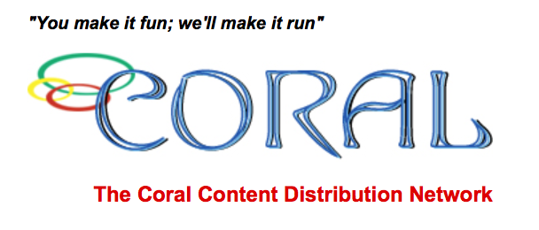
CoralCDN
A free, open, P2P and self-organizing web CDN designed by Michael J. Freedman
No prior registration, authorization, or special configuration needed
Publishing by appending a suffix to a URL’s hostname, e.g., http:/ /example.com.nyud.net/
Designed to automatically and scalably handle sudden spikes in traffic (flash crowds) for new content in services that suffer from overloads
Deployed on the PlanetLab research network (260 servers) between 2004 - 2015
Notes:
URL modification may be done by clients, origin servers, or third parties that link to these domains. Clients accessing such Coralized URLs are transparently directed by CoralCDN’s network of DNS servers to nearby participating proxies. These proxies, in turn, coordinate to serve content and thus minimize load on origin servers.
It can efficiently discover cached content anywhere in its net- work, and it dynamically replicates content in proportion to its popularity.

Slide 81
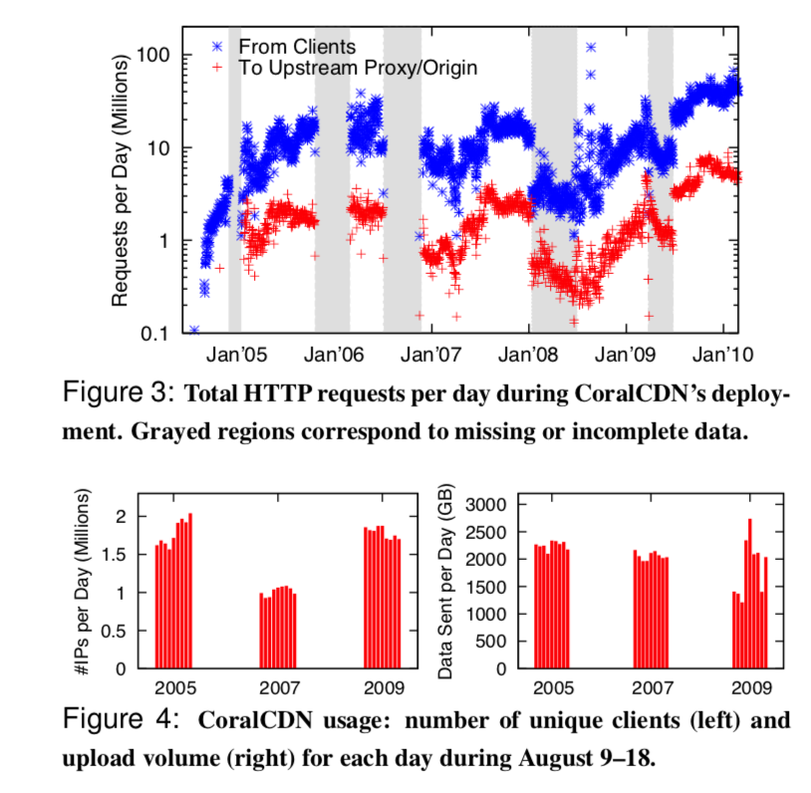
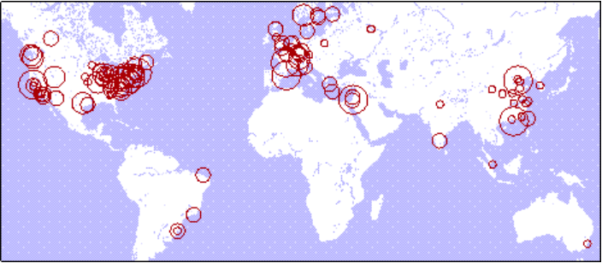
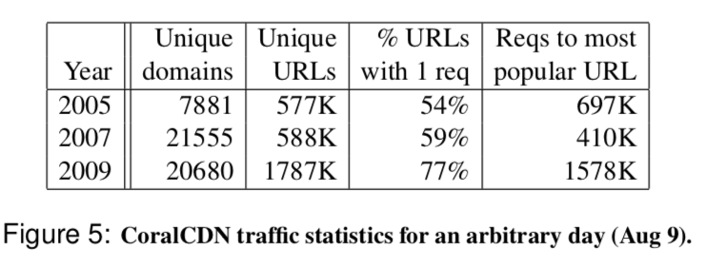
CoralCDN Usage
Notes:
URL modification may be done by clients, origin servers, or third parties that link to these domains. Clients accessing such Coralized URLs are transparently directed by CoralCDN’s network of DNS servers to nearby participating proxies. These proxies, in turn, coordinate to serve content and thus minimize load on origin servers.
It can efficiently discover cached content anywhere in its net- work, and it dynamically replicates content in proportion to its popularity.

Slide 82
Problem Statement/Motivation
Present data collected over the system’s production deployment and its implications
Discuss deployment challenges encountered and describe preferred solutions
Insights for building a secure, open, and scalable content distribution network

Slide 83
Web Security Implications of Open API
CoralCDN as an elastic resource
Simple and friendly API allowed wide + dynamic adoption and misuse
Open API + naming techniques caused security problems from lack of explicitness in specifying protection domains
Notes:
work can be dynamically expanded out to use CoralCDN when websites require additional bandwidth resources, and it can be contracted back when flash crowds abate.
Simple + friendly API that allowed dynamic adoption and misuse: client side like Greasemonkey (automatically rewrite links to popular portals to CoralCDN), serverside (return erroe 302 so that the the content can be served by Coral)

Slide 84
Security Mechanisms
Limiting functionality
Brute-force attacks on websites are slow
Cannot perform anonymous attacks
Reducing excessive resource use
Fair sharing mechanisms to balance bandwidth consumption
Monitoring of both client-side and server side usage
Blacklisting domains and offloading security
Global blacklist for phishing attempts, copyright violations, access control violations
Notes:
Most of it was a consequence of the design: Eg, CoralCDN cannot be used to anonymously launch attacks, as it renoune anonymity. Proxies use unique User-Agent strings (“CoralWebPrx”) and include their identity in Via headers, and they report an instigating client’s IP address to the origin server (in an X-Forwarded-For request header)

Slide 85
Lessons for CDNs
CoralCDN designed to interact with overloaded or poor-behaving servers
Unlike commercial CDNs, Coral cannot grow the size of the network best on expected use

Slide 86
Lessons for CDNs
Designing for faulty origins
Cache negative service results
Serve stale content if origin faulty (<= 24hrs)
Prevent truncations through whole-file overwrites
Decoupling service dependences
Manage oversubscribed bandwidth
Respond with ”Forbidden” when domain oversubscribed
Managing performance jitters
Need to guarantee stability
Notes:
proxies should accept content conservatively and serve results liberally: Namely, if a valid web object is already cached, the new version is written to a temporary file. Only after the new version completes downloading and appears valid (based on Content-Length) will a proxy replace the old one.
.
need for stability in the face of performance variations. – did not quite understand this

Slide 87
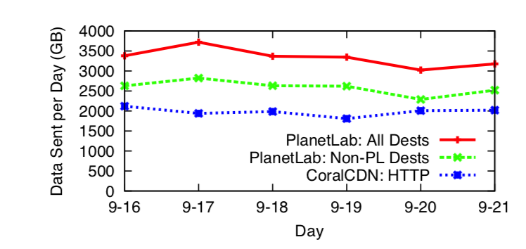
Lessons for Platforms
Application developments could benefit from greater visibility and control of lower layers
Exposing information and expressing preferences across layers
Export greater information to higher levels
Applications push policies to lower levels
Notes:
many resource providers would rather enforce restrictions than assume applications behave well.
PlanetLab began enforcing average daily bandwidth limits per node per service causing possibility of two levels of bandwidth management: admission control by CoralCDN proxies and rate limiting by the underlying hosting platform.
First, these platforms should export greater information to higher levels, such as their current measured resource consumption in a machine-readable format and in real time.
Second, these platforms should allow applications to push policies into lower levels, i.e., an application’s explicit preferences for handling different classes of resources.

Slide 88
Lessons for Platforms
Application developments could benefit from greater visibility and control of lower layers
Exposing information and expressing preferences across layers
Export greater information to higher levels
Applications push policies to lower levels
2. Support for fault-tolerance
Dynamically update root nameserver to reflect change
Announcing IP anycast address via BGP
Notes:
To initially resolve a Coralized URL with no prior knowledge of system participants, a client’s resolver must contact one of only 10–12 CoralCDN name- servers registered with the TLD servers.
Internal recovery does not reflect externally since if one of these nameservers fails—each IP address represents a static PlanetLab server—clients experience long DNS timeouts.

Slide 89
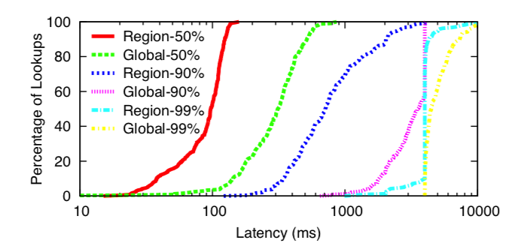
Insights for Building Open CDNs
Coral was overdesigned for its workload
Naming
Levels to support layers of indirection
Content Integrity
End-to-end signature for content integrity through HTTP
Fine-Grain Origin Control
Change origin policy
Notes:
many of its architectural features were over-designed for its current environment and with its current workload: A much simpler design could have sufficed with probably better performance to boot.
D
They have free reign to return modified content. Often, they can even pro- grammatically read and modify any content served directly from a customer website to its clients (either by serving embedded <script>’s or by playing SOP tricks while masquerading as their customer behind a DNS alias).
richer API for elastic CDN services for desired policy in-band

Slide 90
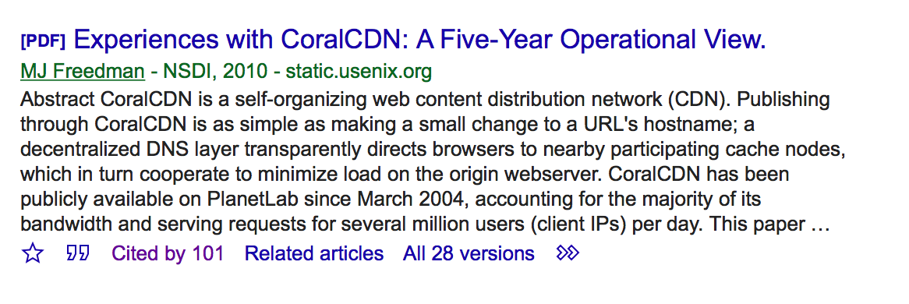
Impact?
Notes:
many of its architectural features were over-designed for its current environment and with its current workload: A much simpler design could have sufficed with probably better performance to boot.
D
They have free reign to return modified content. Often, they can even pro- grammatically read and modify any content served directly from a customer website to its clients (either by serving embedded <script>’s or by playing SOP tricks while masquerading as their customer behind a DNS alias).
richer API for elastic CDN services for desired policy in-band

